Slide 1

Sovereign Debt Explained: Trends, Risks, and Global Case Study
SUBMITTED BY
MAYUKH PAUL REGISTRATION NO – 220010026832
ENROLNMENT NO – 2211212001006
SISTER NIVEDITA UNIVERSITY
KOLKATA- 700156

Slide 2
CONTENT
01
INTRODUCTION
02
DEFINITION & IMPORTANCE
03
RISK FACTOR
04
TREND & STATISTICS
05
CASE STUDY
06
CONCLUSION

Slide 3

INTRODUCTION
Sovereign debt is a form of public debt issued by a national government, usually in the form of bonds, to raise funds for public spending.
Why is it important?
Funds Essential Government Services
Supports Economic Stability
Enables Investment in Growth
Impacts Global Markets
#01

Slide 4

01
Understanding Sovereign Debt
#02

Slide 5

DEFINITION AND IMPORTANCE
→
Sovereign debt is a type of public debt issued by a sovereign government, typically in the form of bonds, to finance public spending.is referred to as sovereign debt.
→
It comes in two main types: Domestic debt, which is issued and repaid in the country’s own currency and sold to local investors, and
Foreign (external) debt, which is issued in foreign currencies and held by international creditors.
→
How governments borrow
- Governments usually borrow by issuing bonds—debt securities that promise to pay back the principal with interest over time. These bonds can be sold to individuals, institutions, or other countries, making sovereign debt a vital tool for managing national finances.
#03

Slide 6
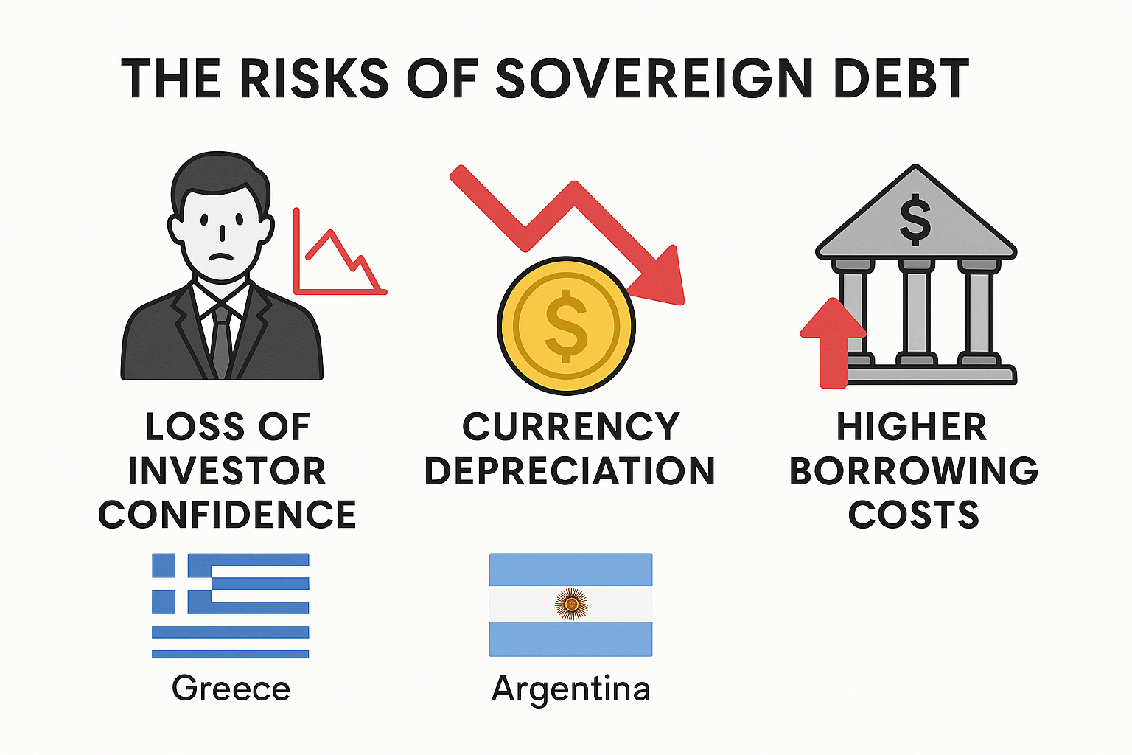
THE RISK OF SOVEREIGN DEBT
High sovereign debt can undermine a country's financial stability and trigger serious economic consequences:
Loss of investor confidence
When debt become unsustainable, investor may pull out, leading to capital flight.
Example: When Greece debt crisis 2010 happened, investor doubted Greece ability to repay causing bond yields skyrocket
Currency depreciation
Heavy debt and fear of default can weaken national currency
Example: When Argentina (2018-2020)- high debt and inflation led to peso collapse and multiple IMF ballot
3. Higher Borrowing Cost
Countries with high debt pay more to borrow as lender demand higher return to offset the risk
Example: Italy(2022)- Political instability and debt concern led to spike in bond yields
#04

Slide 7
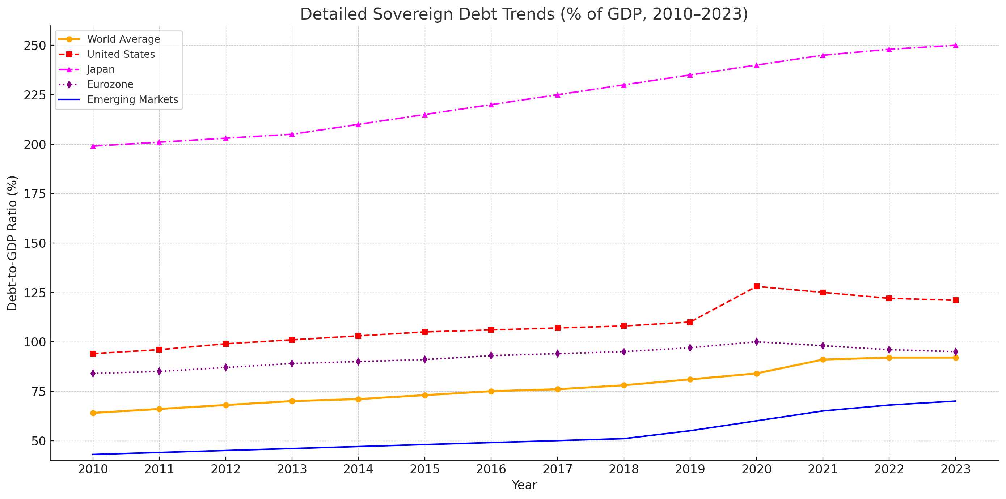
RECENT TREND AND STATISTICS
As we can see, the world average has been rising steadily, especially after 2020. This reflects the global borrowing surge during the COVID-19 pandemic
The U.S. saw a sharp increase in debt levels around 2020–2021, jumping from about 110% to over 125%, due to massive stimulus spending
Japan has consistently had the highest debt-to-GDP ratio, now around 250%, which is a result of decades of borrowing to stimulate its economy. The Eurozone shows a moderate rise and then a slight decline, thanks to fiscal tightening in some member states.
Emerging economies started with lower debt but are showing a clear upward trend, highlighting growing risks in developing countries.
Overall, this graph emphasizes a global shift toward higher sovereign debt, raising concerns about financial stability, especially as interest rates rise.
Secondary Data
Source: International Monetary Fund (IMF), World Economic Outlook Database, April 2023. Retrieved from https://www.imf.org/en/Publications/WEO
#05

Slide 8

CASE STUDY:
THE EUROPEAN DEBT CRISIS
Background: Post-2008 financial crisis triggered debt concerns in several Eurozone countries
The European Debt Crisis emerged in the aftermath of the 2008 financial crisis, exposing deep fiscal vulnerabilities in the Eurozone.
Greece became the epicenter, with revelations of misreported deficits and unsustainable debt levels. Spain and Italy were pulled in due to weak banking systems and rising debt costs.
The European Central Bank and IMF played crucial roles—offering bailouts and implementing bond-buying programs to stabilize markets.
The crisis highlighted the risks of having a shared currency like the euro without coordinated fiscal oversight. It ultimately led to reforms aimed at improving financial governance in the EU.
→
#06

Slide 9
CONCLUSION
Sovereign debt is a critical tool for funding government needs—but when mismanaged, it can lead to economic instability.
Global trends show rising debt levels, especially after crises like the COVID-19 pandemic.
Effective management requires a careful mix of policy choices—from austerity and stimulus to restructuring and reform.
Institutions like the IMF and World Bank play a key role in stabilizing debt-stricken nations.
Transparency, accountability, and strong fiscal rules are essential for maintaining investor trust and long-term sustainability.
Balancing the need to borrow and the obligation to repay—without jeopardizing economic stability.
#07

Slide 10

THANK YOU

